Slide 1
Some discussion on good data science (ML) development practices
With focus in Academia :D
Maria Han Veiga

Slide 2

Google guidebook
I read it so you don’t have to, jk you still should: https://developers.google.com/machine-learning/guides/rules-of-ml

Slide 3
Rule #1: Don’t be afraid to launch a product without machine learning.
Notes:
There’s a lot of things outside of the ML model — from fetching the data, cleaning, to some sort of prediction.

Slide 4
Rule #4: Keep the first model simple and get the infrastructure right.
The first model provides the biggest boost to your product, so it doesn't need to be fancy. But you will run into many more infrastructure issues than you expect. Before anyone can use your fancy new machine learning system, you have to determine:
- How to get examples to your learning algorithm.
- A first cut as to what "good" and "bad" mean to your system.
- How to integrate your model into your application.
The features reach your learning algorithm correctly.
- The model learns reasonable weights.
- The features reach your model in the server correctly.
Your simple model provides you with baseline metrics and a baseline behavior that you can use to test more complex models. Some teams aim for a "neutral" first launch: a first launch that explicitly de­prioritizes machine learning gains, to avoid getting distracted.

Slide 5
Rule #5: Test the infrastructure independently from the machine learning.
Make sure that the infrastructure is testable, and that the learning parts of the system are encapsulated so that you can test everything around it. Specifically:
Test getting data into the algorithm. Check that feature columns that should be populated are populated. Where privacy permits, manually inspect the input to your training algorithm. If possible, check statistics in your pipeline in comparison to statistics for the same data processed elsewhere.
Test getting models out of the training algorithm. Make sure that the model in your training environment gives the same score as the model in your serving environment (see Rule #37).

Slide 6
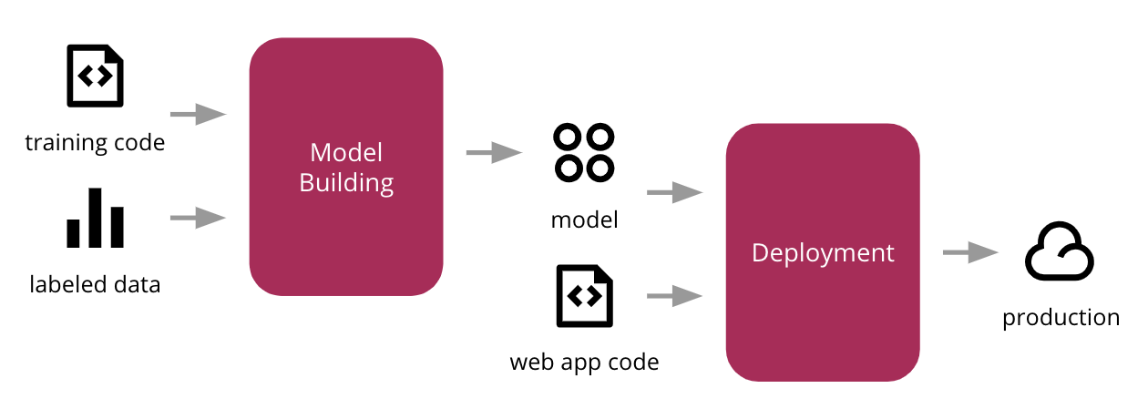
Why these 43 rules aren’t SUPER important for us
Iterative process
Business question
Paper
Scientific question
Dataset
Notes:
The continuous deployment is not VERY relevant in academia. What is relevant is storage and reproducibility. And obvious, a solid pipeline.

Slide 7
Why these 43 rules aren’t SUPER important for us
Iterative process
Business question
Common goals
Paper
Scientific question
Dataset
Notes:
The continuous deployment is not VERY relevant in academia. What is relevant is storage and reproducibility. And obvious, a solid pipeline.

Slide 8

DeepMind’s take
I read it so you don’t have to, jk you still should: https://deepmind.com/blog/article/robust-and-verified-ai

Slide 9
3 rules
Testing consistency with specifications efficiently: Does my model behave the according to whatever I am trying to model (e.g.: is it invariant, is it robust, does the prediction always make sense?) Search for worst-case outcomes.
Training machine learning models to be specification-consistent: Even if you have a large dataset, it doesn’t mean that you will be able to make a model which is specification-consistent.
Formally proving that machine learning models are specification-consistent: I think this is the dream.
Notes:
We explore efficient ways to test that machine learning systems are consistent with properties (such as invariance or robustness) desired by the designer and users of the system. One approach to uncover cases where the model might be inconsistent with the desired behaviour is to systematically search for worst-case outcomes during evaluation.

Slide 10
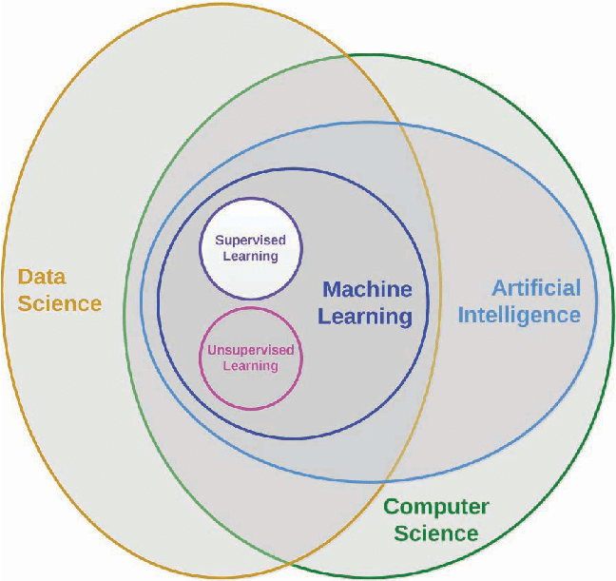
Scientific pipelines
A total abyss
Natural Sciences
Let’s chat

Slide 11
How do you go about solving a problem with ML?

Slide 12
How do you keep track of the code?

Slide 13
How do you keep track of the results?

Slide 14
What happens to the project after it’s concluded?

Slide 15

Useful tools?
Let’s chat

Slide 16
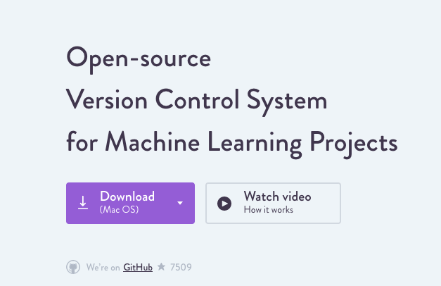
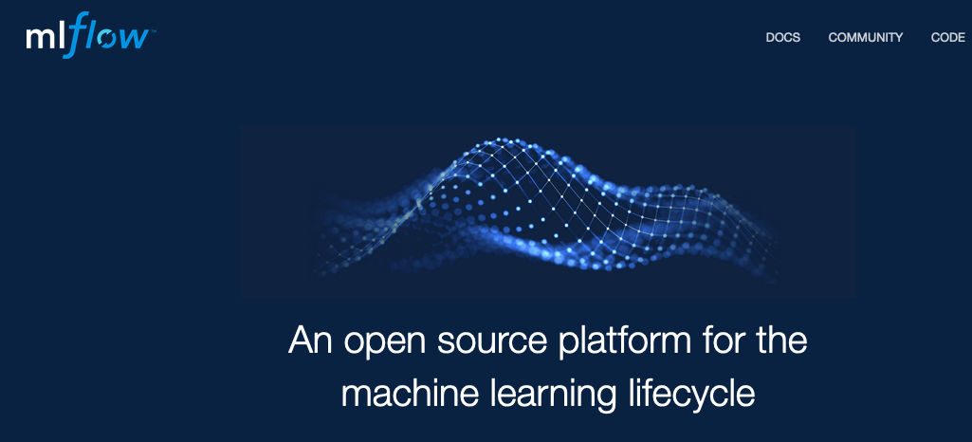

Useful tools I want to use but haven’t
https://dvc.org/
https://mlflow.org/
https://github.com/google/jax

Slide 17

Personal stories
Let’s share some stories of pain, suffering and success
All I get are NaNs

Slide 18
Personal stories
Of near-failure
Problem was not well defined
Very multidisciplinary team
Bad coding practices

Slide 19
Personal stories
Of near-failure
Problem was not well defined
Very multidisciplinary team
Bad coding practices
Many months spent on re-defining the problem
Lots of bugs in the code as development progressed
An overall unpleasant experience

Slide 20
Personal stories
Of success
We spent 1 year discussing the utility and need of ML in the problem
A lot of time spent on blackboard to write the pipeline
Good coding practices
LOTS OF CODE REVIEW/INTEGRATION
Less multidisciplinary team (2 mathematicians, 2 physicists)
https://github.com/mtimpe/aegis-emulator

